Slide 1
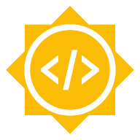
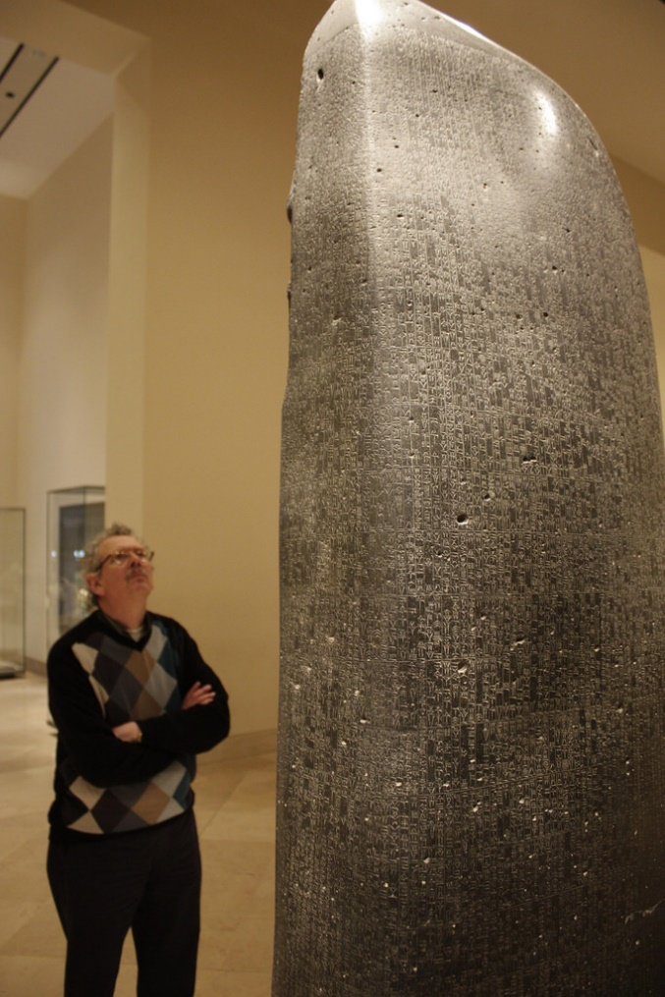

Classical Language ToolKit (CLTK)
“The Road to CDLI’s Corpora Integration into CLTK: An Undertaking”
Andrew Deloucas
Ph.D. Student, Harvard University
Topics of Interest: Python, Natural Language Processing, Study of the Ancient World
Notes:
Hello, my name is Andrew Deloucas and I am an incoming first-year Ph.D. student at Harvard University. I’m presenting on behalf of the Classical Language ToolKit, or CLTK for short.
My project for this year’s Google Summer of Code is titled “The Road to CDLI’s Corpora Integration into CLTK: an Undertaking”.
This project focuses on the use of Python, Natural Language Processing (or NLP), and the Study of the Ancient World, specifically the language of Akkadian, an ancient Semitic language spoken and written in the Middle East for over three thousand years.
Akkadian may be familiar to you through the Epic of Gilgamesh, Code of Hammurabi (pictured), the existence of Pythagorean Triples one thousand years before Pythagoras was born, and calculating the planet Jupiter’s trajectory using techniques previously thought invented only in Oxford during the 15th century AD.

Slide 2

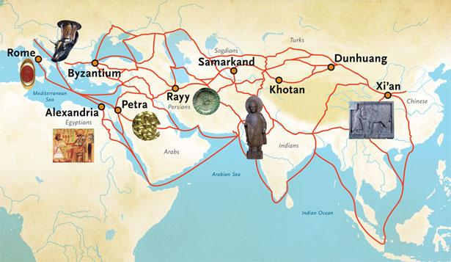
CLTK - www.cltk.org
The Classical Language Toolkit (CLTK):
is a free and open source Python package for doing NLP in ancient languages
offers language-specific tokenizers, lemmatizers, parts-of-speech taggers, morphological parsers, word embeddings, etc.
Notes:
The CLTK is a free and open-source Python package that offers natural language processing (NLP) support for the languages of Ancient, Classical, and Medieval Eurasia.
Some example languages outside of Latin, Greek or Akkadian include Javanese, Coptic, Marathi, Old Norse, Pali and French.
The goals of this community are 1) good analysis-friendly corpora/datasets for NLP of historical languages, 2) collect & generate linguistic data for quantified classics, 3) Framework for an integrated study of the ancient world.

Slide 3
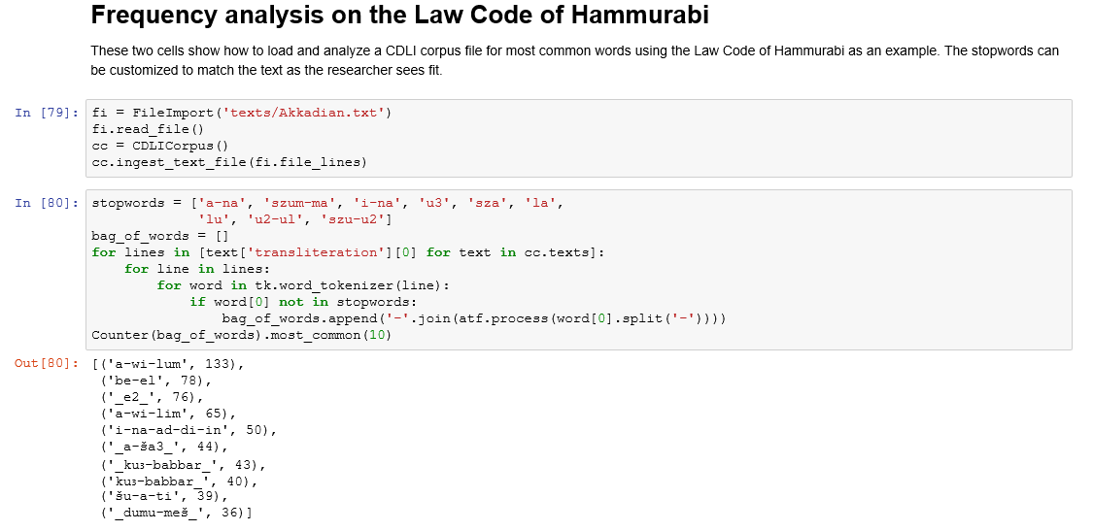
The Road to CDLI’s Corpora Integration
Integrating Akkadian as a function:
File Importation
Text tokenization
Unicode Conversion
Lemmatization
Pretty-printing
Cuneiform Digital Library Initiative (CDLI): https://cdli.ucla.edu/
Open Richly Annotated Cuneiform Corpus (ORACC): http://oracc.museum.upenn.edu/index.html
Notes:
My summer project establishes the foundational building blocks of processing Akkadian in the CLTK; an example of how we can now process text is via frequency analysis, or the analysis of word frequency in a body of text, shown on the right.
Because Akkadian is a three-dimensional language embedded on objects such as clay tablets, bricks, and stone reliefs, each one of these materials is treated like a museum artifact. So, with every one-inch by one-inch clay tablet or meters-long monolithic inscription you have information on every text’s time period and provenance, size of the object, publication and translation if any, etc.
If you’re interested in this topic, I recommend exploring the Cuneiform Digital Library Initiative (CDLI) and Open Richly Annotated Cuneiform Corpus (ORACC), the two largest online databases hosted by UCLA, Oxford University, and University of Berlin. Between these two projects, they house thousands of cuneiform texts for Sumerian, Akkadian, Hurrian, and Hittite languages. Likewise, check out the CLTK, where you can learn how to import and utilize Akkadian for your own interest and use by summer’s end.
Thank you!

